Slide 1
Walmart Sales Dashboard
Interactive Dashboard Insights for Business Stakeholders

Slide 2
Key Performance Indicators (KPIs)
- Total Sales: $6,737,218,987
- Average Weekly Sales: $1,046,965
- Top Store: Store 20 ($301,397,792)
- Holiday Sales Boost: 7.84%

Slide 3
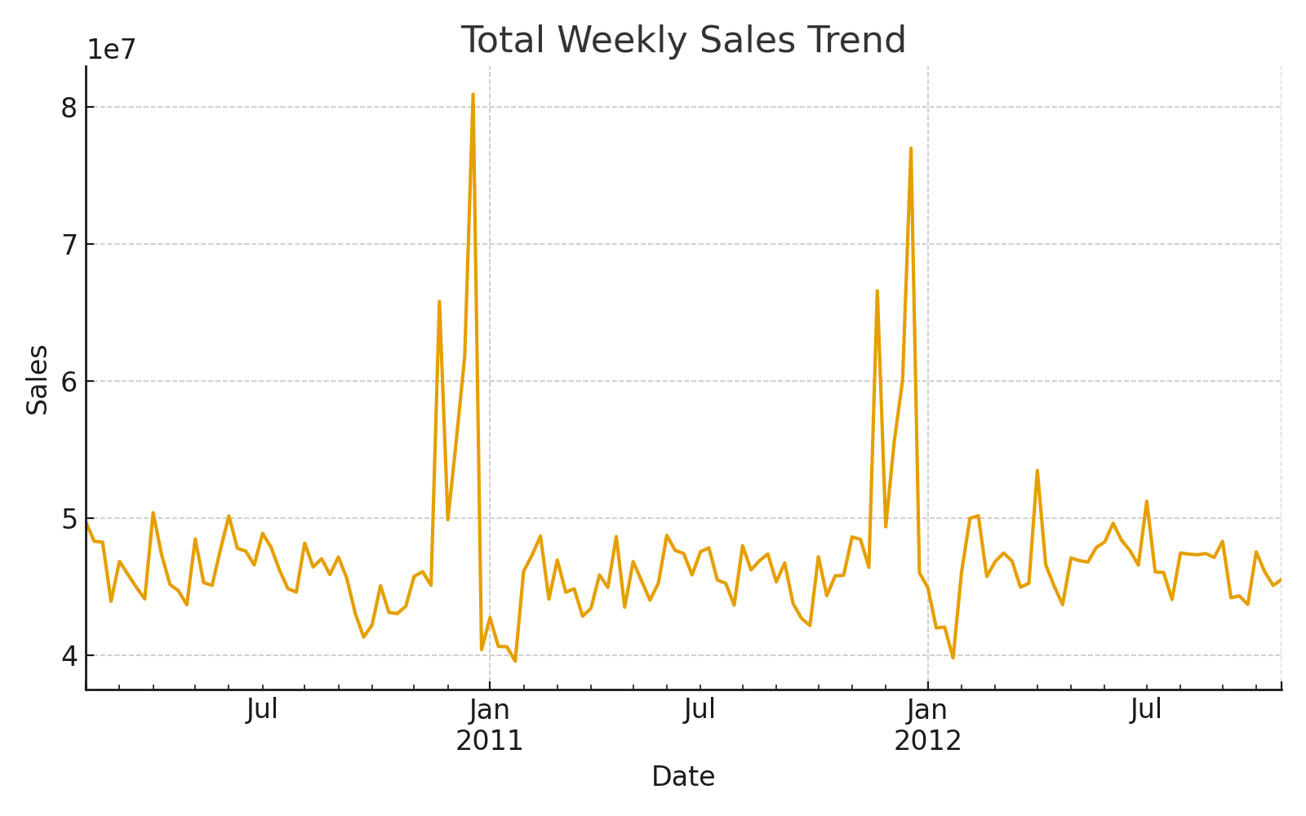
Sales Trend Over Time

Slide 4
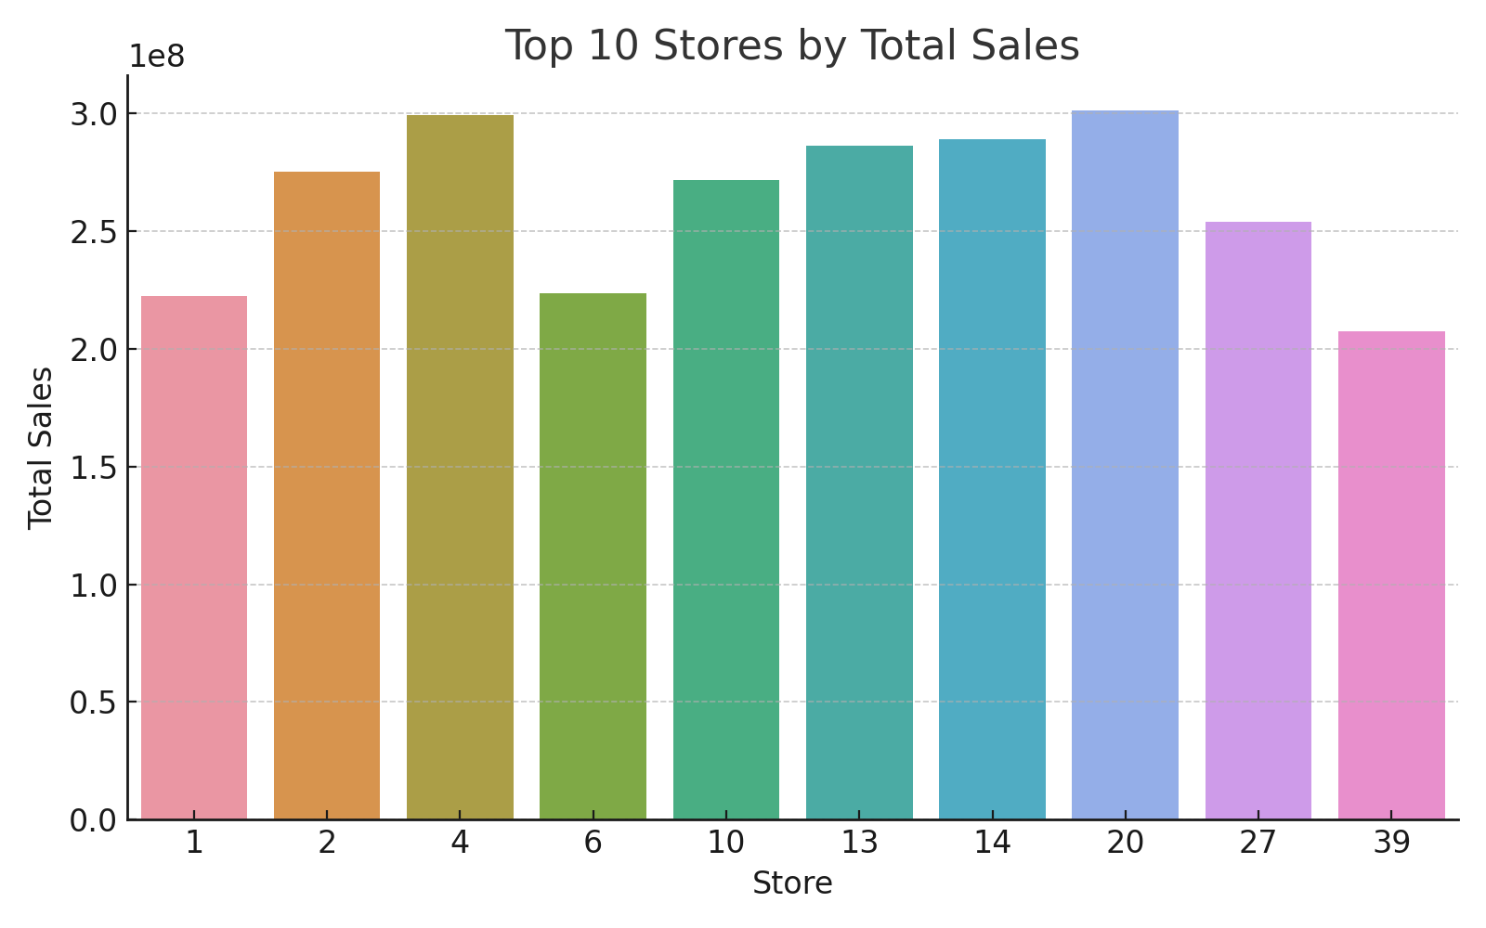
Top 10 Stores by Sales

Slide 5
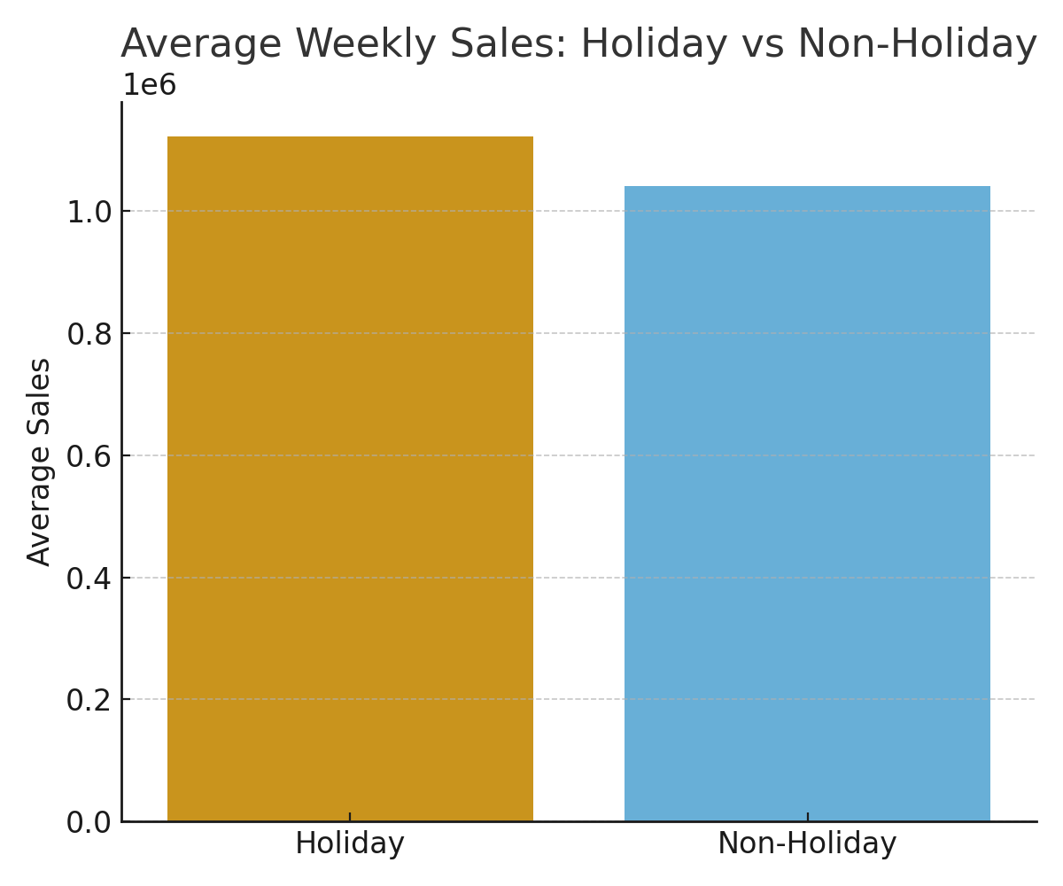
Holiday vs Non-Holiday Sales

Slide 6
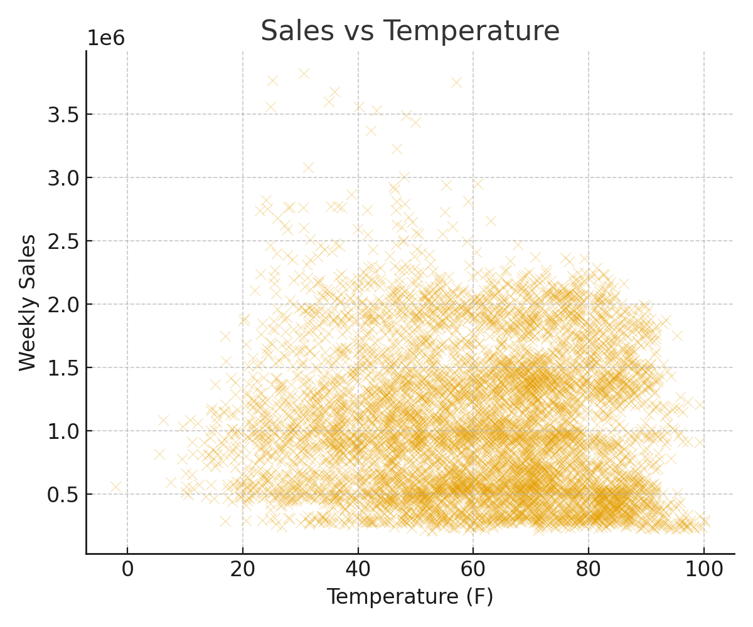
Impact of Temperature on Sales

Slide 7
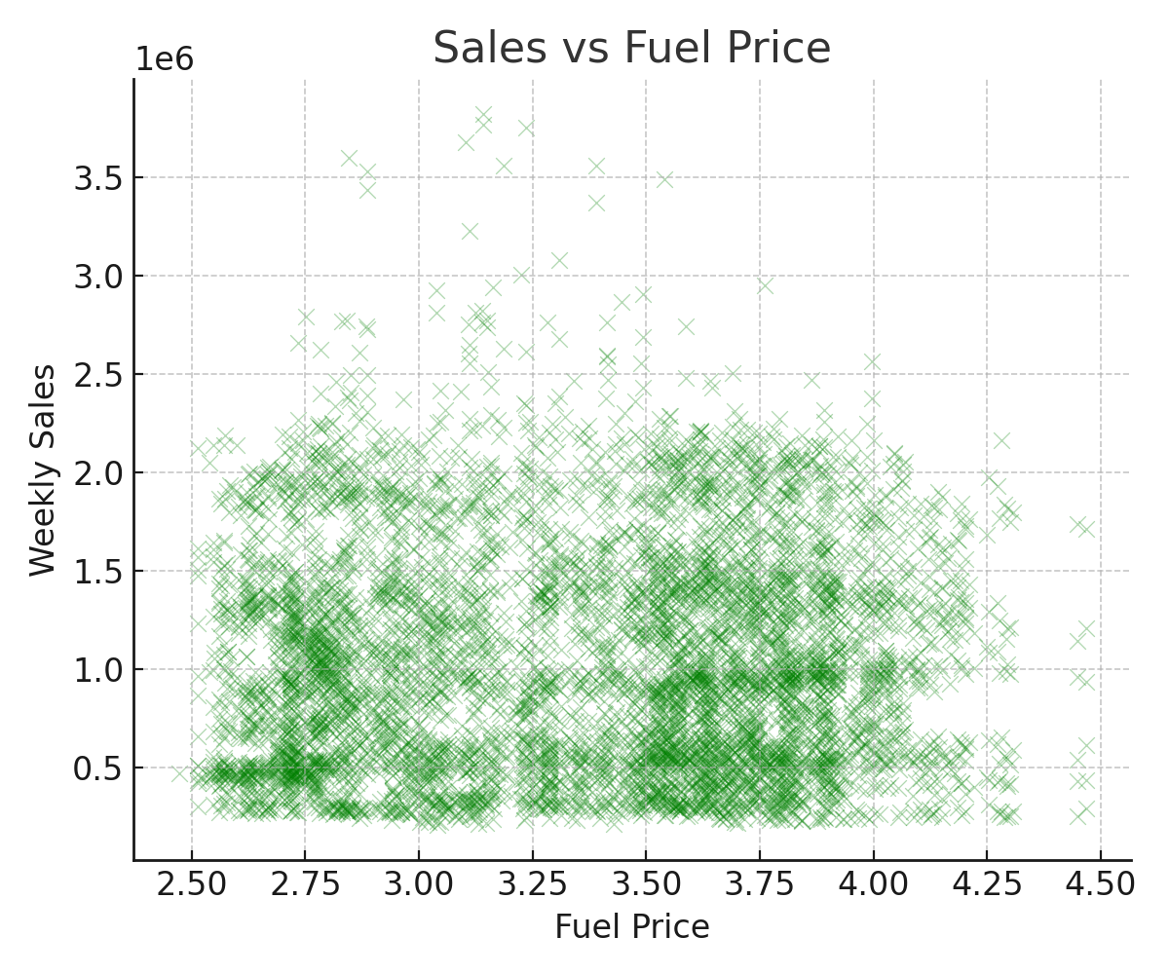
Impact of Fuel Price on Sales

Slide 8
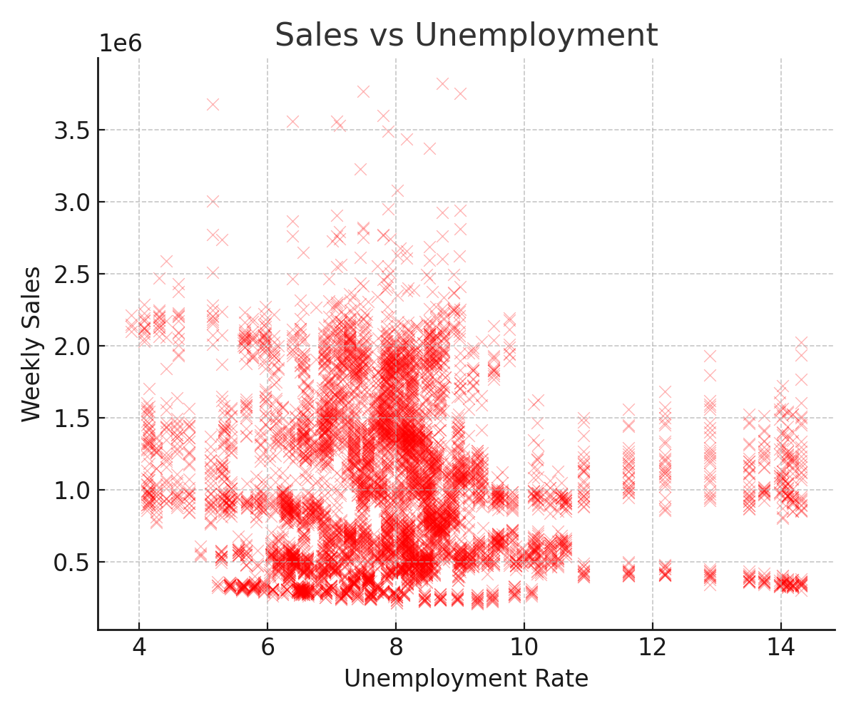
Impact of Unemployment on Sales

Slide 9
Key Insights & Recommendations
- Sales show seasonal peaks during holidays.
- Store performance varies; Store 20 is leading significantly.
- Holiday weeks drive {holiday_boost:.2f}% higher sales.
- External factors (Temperature, Fuel Price, Unemployment) show weak correlation with sales.
- Recommendation: Focus promotional campaigns around holidays and replicate best practices from top-performing stores.

Slide 10
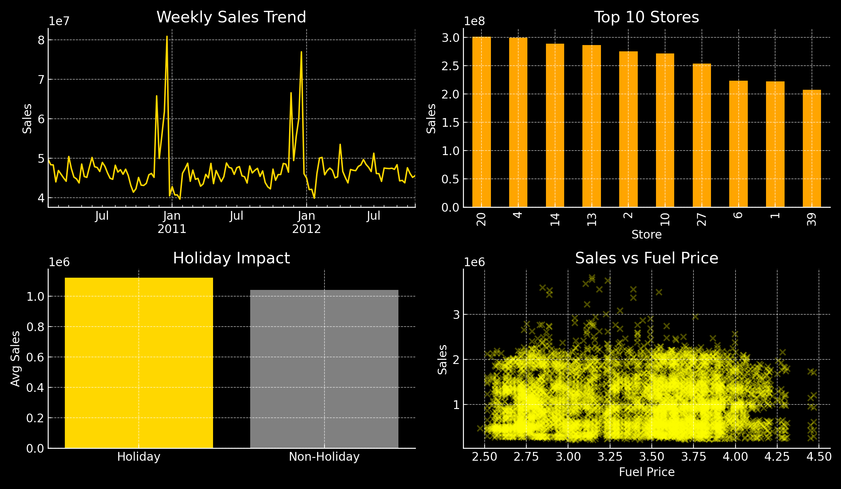
Dashboard Overview (Power BI Style)

Slide 11
Executive Summary
🔹 Total Sales across all stores exceeded $6,737,218,987.
🔹 Store 20 leads with the highest contribution.
🔹 Holiday weeks boost sales by 7.84% compared to non-holidays.
🔹 External factors like Fuel Price and Unemployment have limited correlation with sales.
✅ Recommendation: Focus on holiday promotions and replicate best practices from top-performing stores.

